Slide 1
MGS 723: Geodynamics
Class 9: Viscous deformation II
Main reference for today: Becker and Faccenna, Tectonic Geodynamics

Slide 2
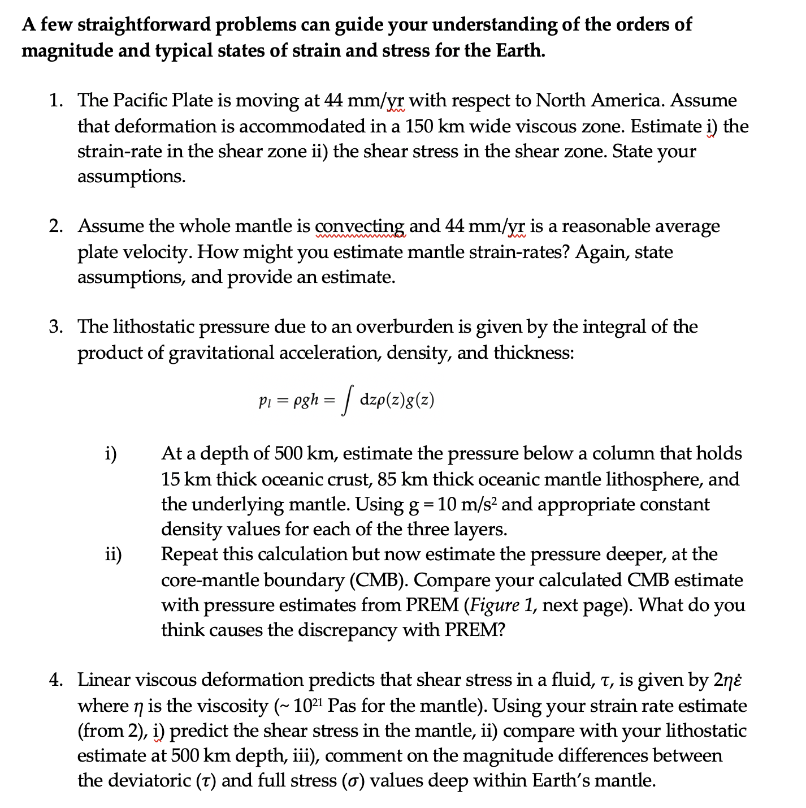
Problem Set #1: Part A

Slide 3
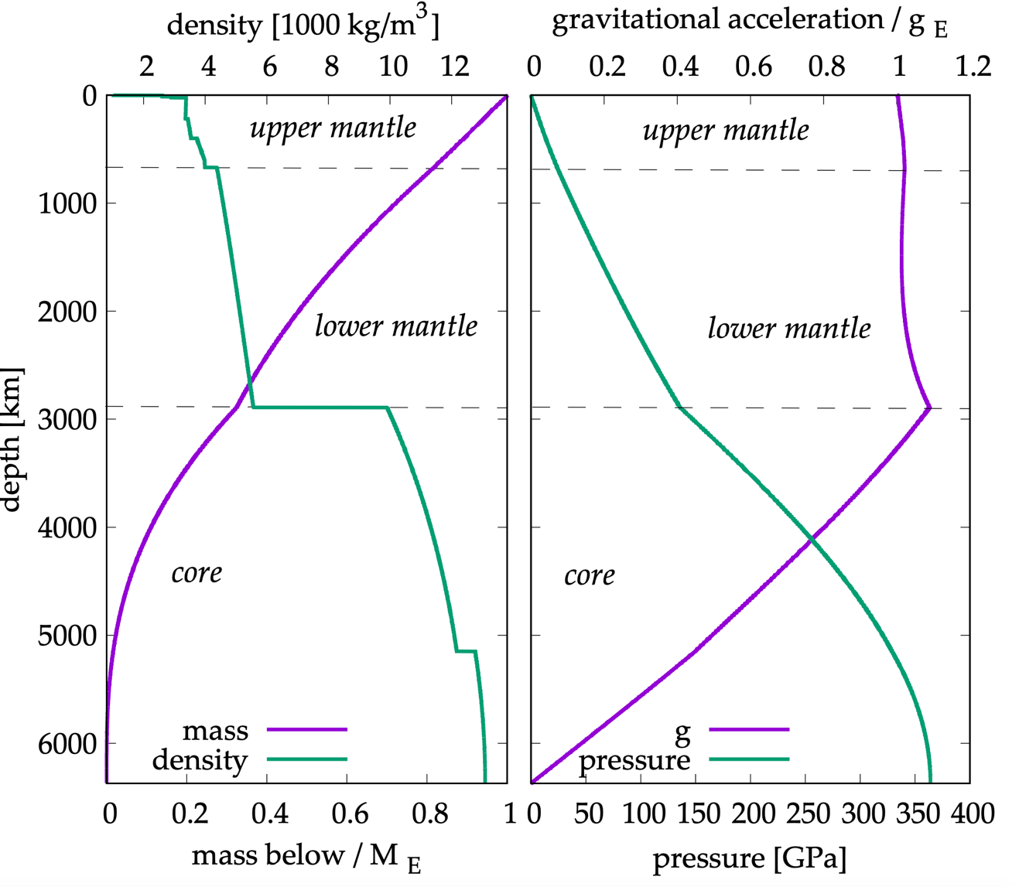

Slide 4
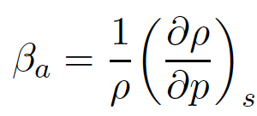
T&S – Sect. 4.28
Adiabatic compression (no heat into/out of the element, constant entropy)
Adiabatic
compressibility:

Slide 5
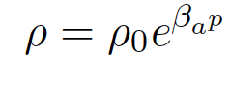
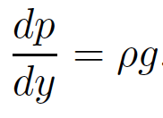
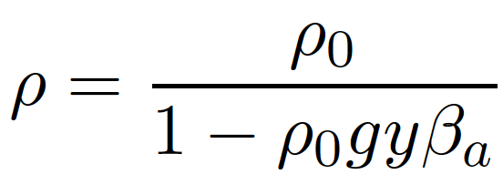
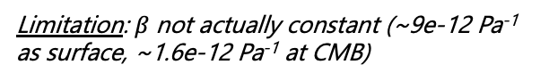
T&S – Sect. 4.28
Adiabatic compression (no heat into/out of the element, constant entropy)
Adiabatic
compressibility:
And:
Combining and integrating gives:
Limitation: $β$not actually constant (~9e-12 Pa⁻¹ as surface, ~1.6e-12 Pa⁻¹ at CMB)

Slide 6
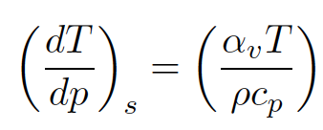
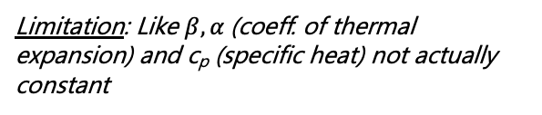
T&S – Sect. 4.28
Adiabatic compression (no heat into/out of the element, constant entropy)
Adiabatic compression (no heat into/out of the element, constant entropy)
Also produces temperature increase with depth:
Adiabatic
compressibility:
Limitation: Like $β, α$(coeff. of thermal expansion) and c_{p} (specific heat) not actually constant
And:
Combining and integrating gives:
Limitation: $β$not actually constant (~9e-12 Pa⁻¹ as surface, ~1.6e-12 Pa⁻¹ at CMB)

Slide 7
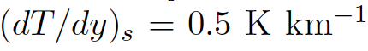
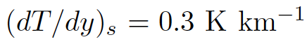
T&S – Sect. 4.28
Adiabatic compression (no heat into/out of the element, constant entropy)
Adiabatic compression (no heat into/out of the element, constant entropy)
Also produces temperature increase with depth:
Adiabatic
compressibility:
Limitation: Like $β, α$(coeff. of thermal expansion) and c_{p} (specific heat) not actually constant
And:
In upper mantle:
Combining and integrating gives:
Much deeper
Limitation: $β$not actually constant (~9e-12 Pa⁻¹ as surface, ~1.6e-12 Pa⁻¹ at CMB)

Slide 8
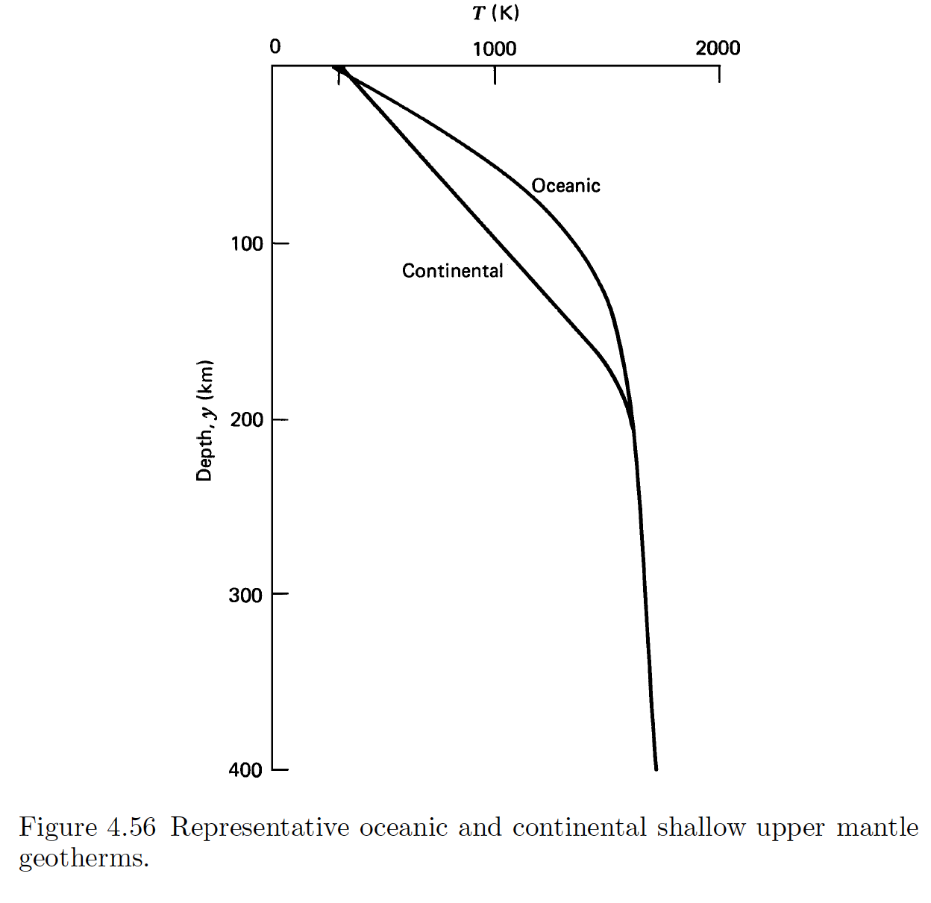
Adiabatic compression (no heat into/out of the element, constant entropy)
Also produces temperature increase with depth:
Limitation: Like $β, α$(coeff. of thermal expansion) and c_{p} (specific heat) not actually constant
In upper mantle:
Much deeper

Slide 9
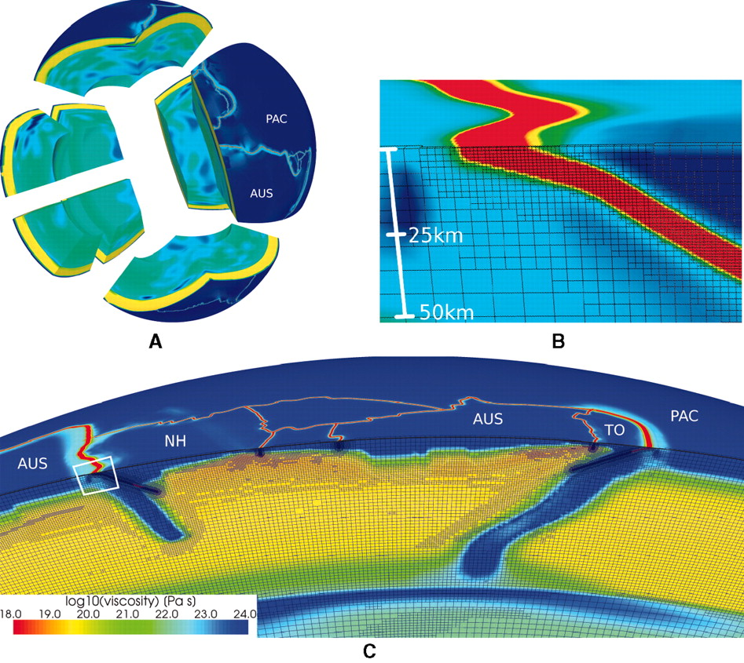
Weak plate boundaries
Stadler et al., 2010

Slide 10
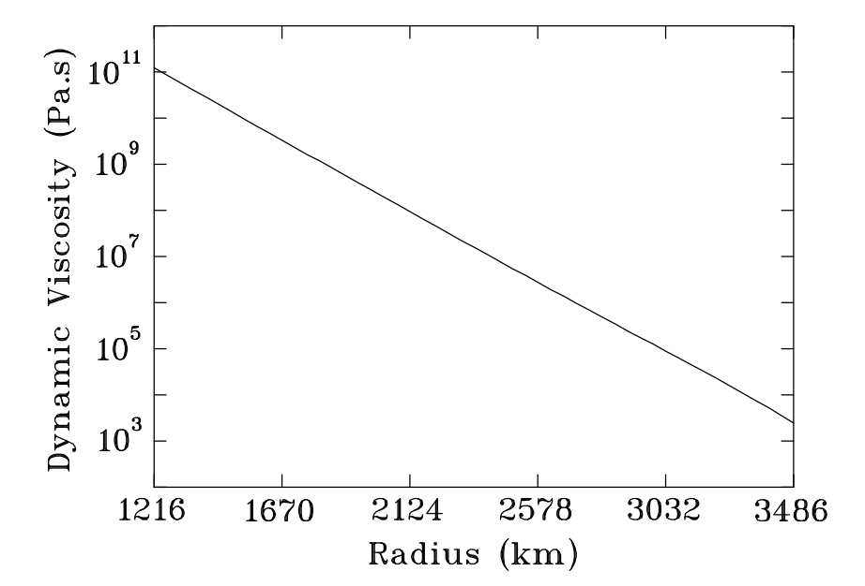
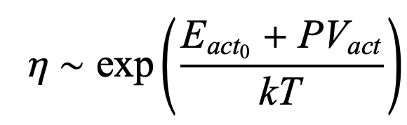
Outer core viscosity
Smylie and Palmer, 2007, preprint

Slide 11
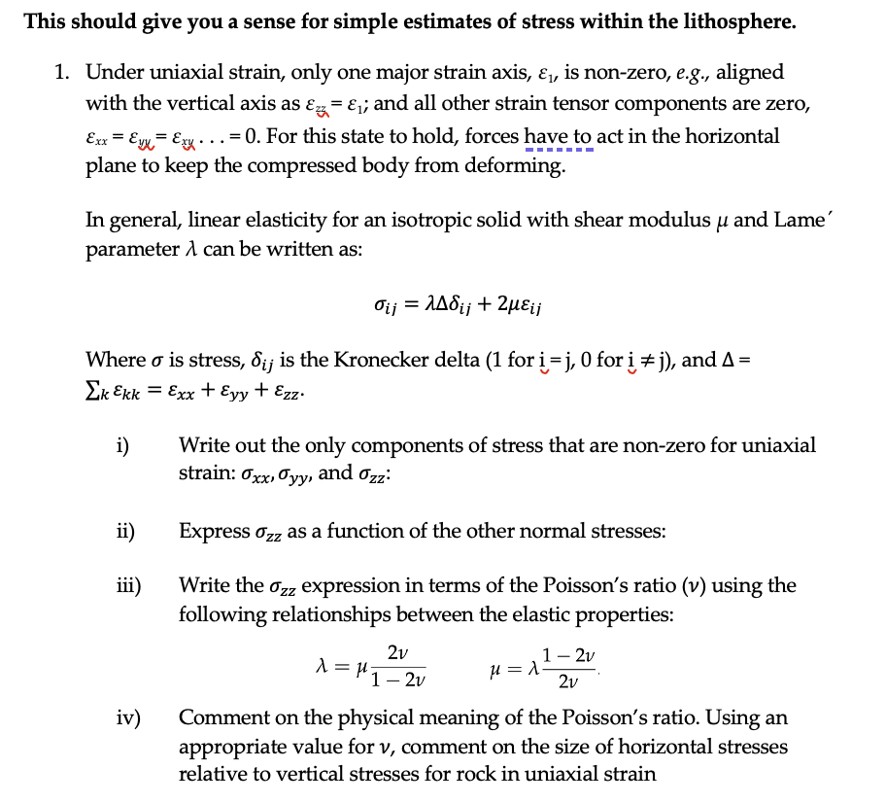
Problem Set #1: Part B1

Slide 12
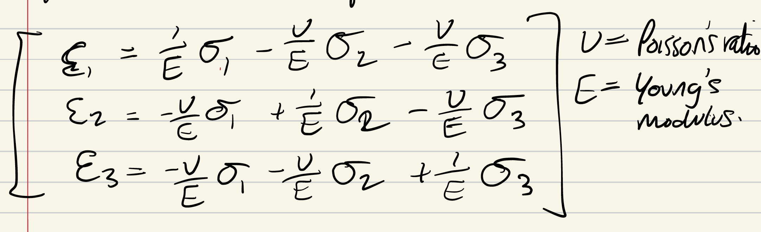
Poisson’s Ratio?

Slide 13

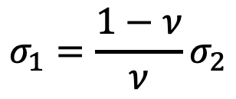
Poisson’s Ratio?
For uniaxial stress:
For uniaxial strain:
$$σ_{1}=\frac{1−ν}{ν}σ_{2}$$

Slide 14
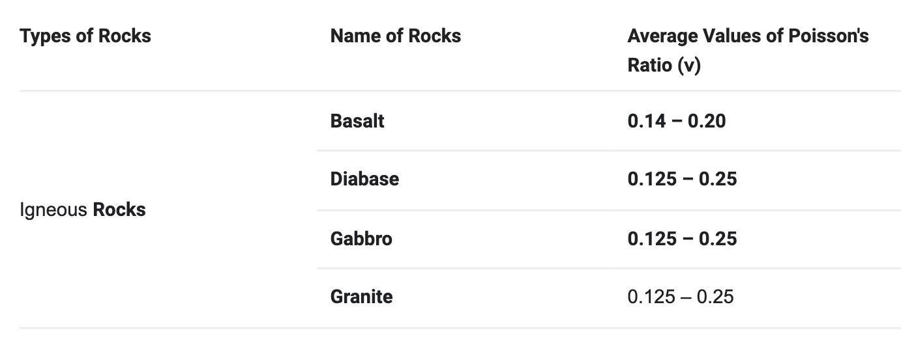
Poisson’s Ratio?
For uniaxial stress:
For uniaxial strain:
$$σ_{1}=\frac{1−ν}{ν}σ_{2}$$

Slide 15
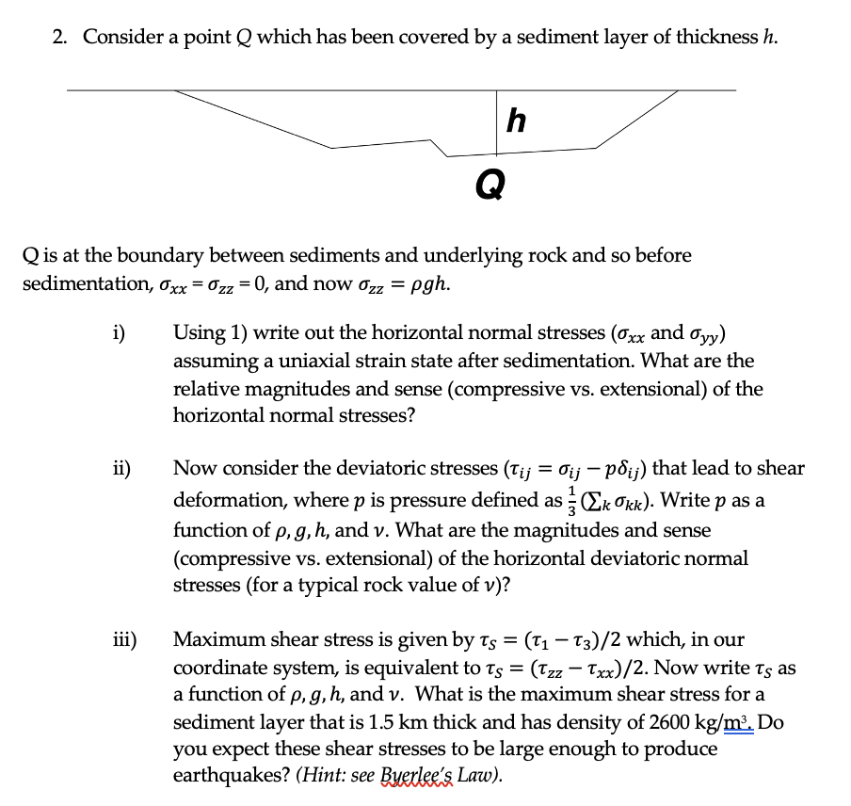
Problem Set #1: Part B2

Slide 16
Problem Set #1: General comments
Please provide digital copies (scans) and pen preferred.
State where you get your numbers (e.g., material properties) from!
Always state your assumptions (e.g., whole mantle convection for Part A?)
Don’t quote overly precise numbers – One significant figure typically fine for back-of-envelope calculations e.g., stress/strain rates of Part A.

Slide 17
Problem Set #1: General comments
Please provide digital copies (scans) and pen preferred.
State where you get your numbers (e.g., material properties) from!
Always state your assumptions (e.g., whole mantle convection for Part A?)
Don’t quote overly precise numbers – One significant figure typically fine for back-of-envelope calculations e.g., stress/strain rates of Part A.
Overall, well done!

Slide 18
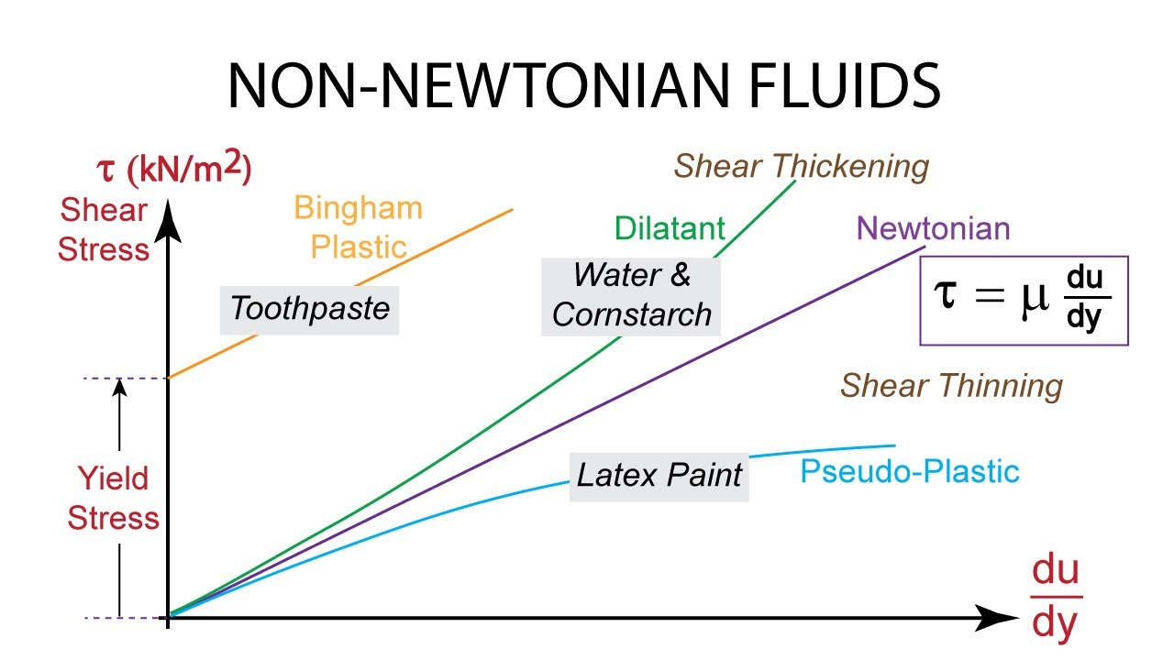
Back to fluids:
We ended last class talking about non-Newtonian flow:

Slide 19
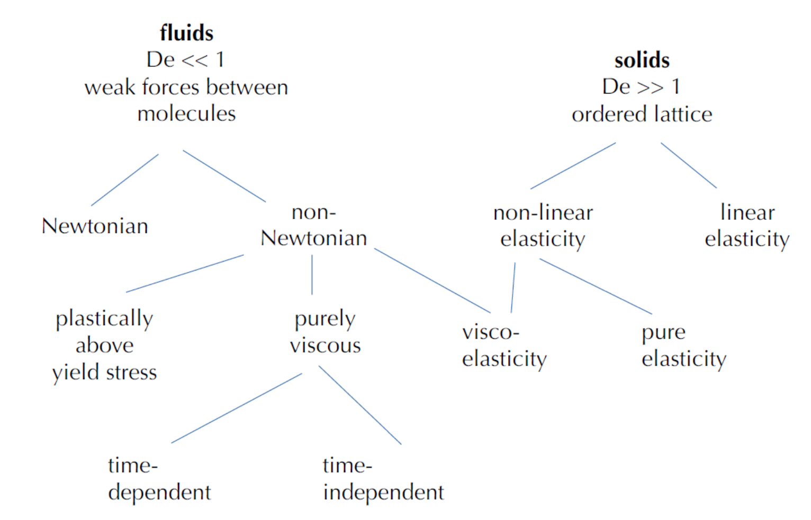
Rheology
Becker and Faccenna

Slide 20
Rheology
Becker and Faccenna

Slide 21

To the stylus…
To: understand Newtonian vs. non-Newtonian fluids, “effective” viscosity concept, plasticity

Slide 22
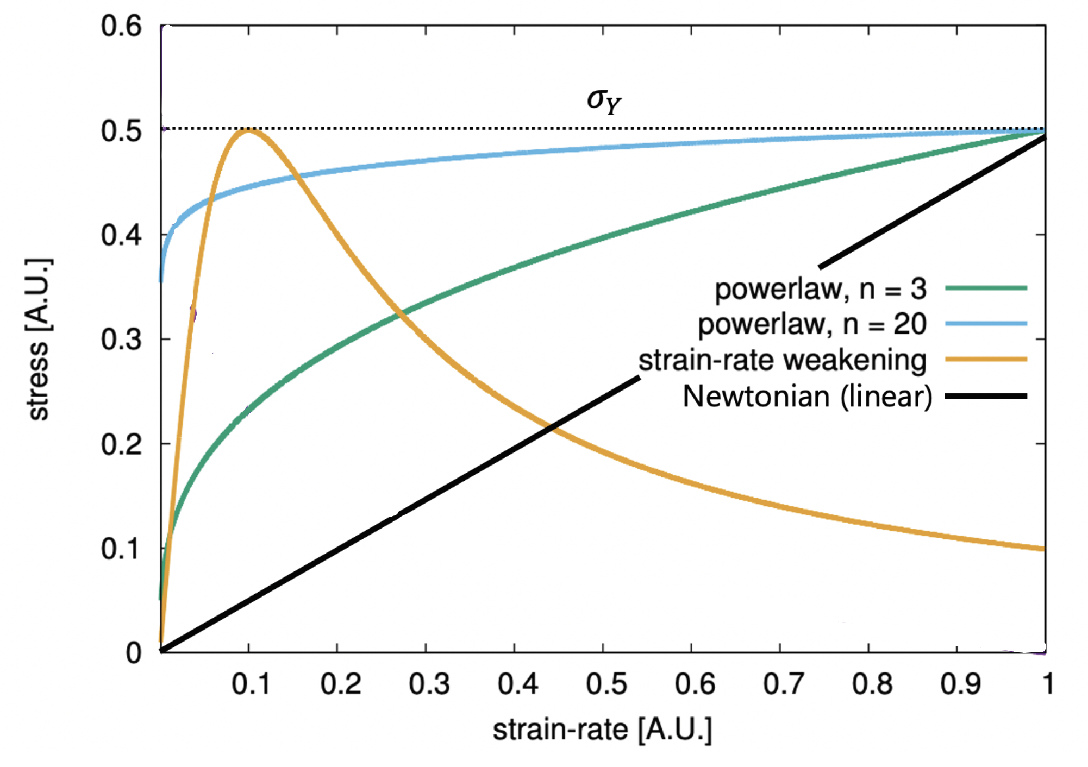
Power-law flow mimics plasticity as n $→∞$
Becker and Faccenna

Slide 23

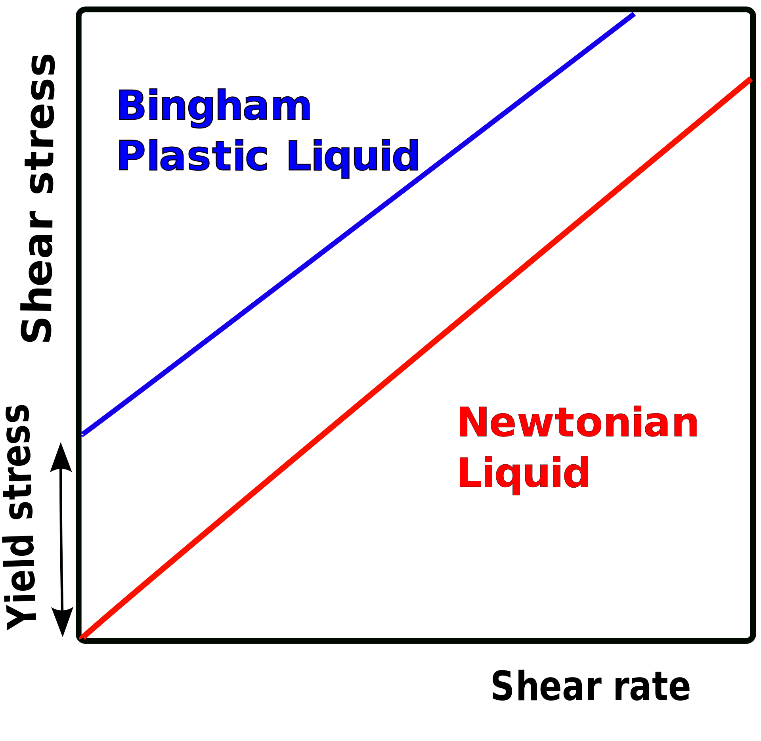
Toothpaste
Toothpaste: A Bingham plastic:
Deformation rate zero below yield stress
Fluid like behavior above yield stress

Slide 24
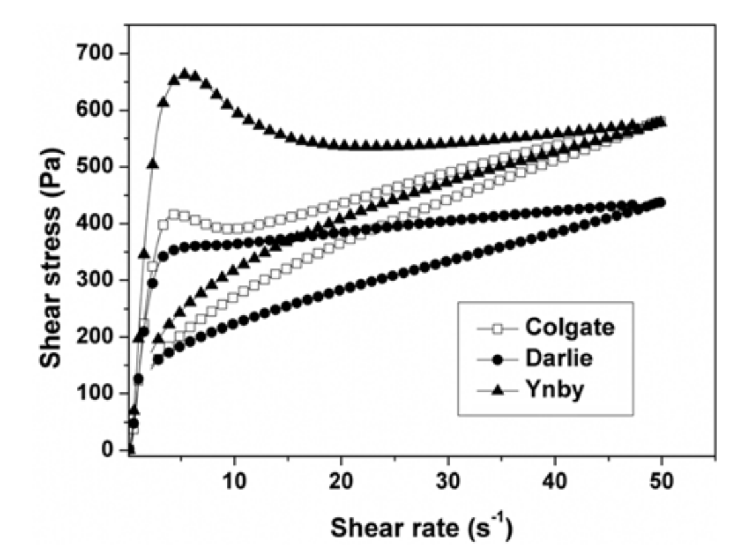
Toothpaste
Toothpaste: A Bingham plastic:
Deformation rate zero below yield stress
Fluid like behavior above yield stress
Liu et al., 2012

Slide 25
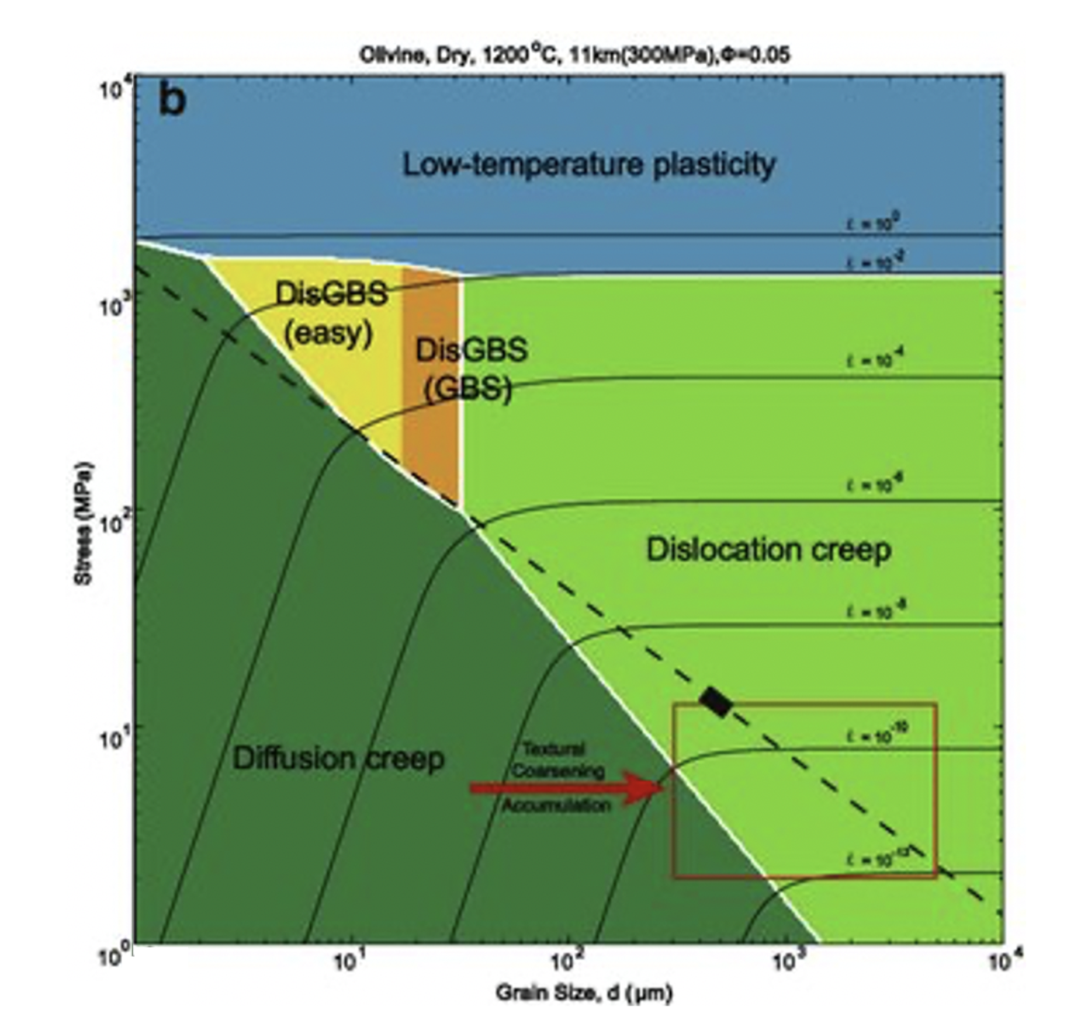
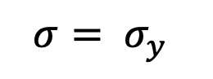
Next class: Viscous flow in the mantle
Zhuosen et al., 2017
$$σ= σ_{y}$$
$$σ^{n}∝\dot{ε}$$
$$σ∝\dot{ε}$$
Notes:
https://www.researchgate.net/publication/316874615_Kinetic_processes_for_plastic_deformation_of_olivine_in_the_Poyi_ultramafic_intrusion_NW_China_Insights_from_the_textural_analysis_of_a_1700_m_fully_cored_succession/figures?lo=1

Slide 26
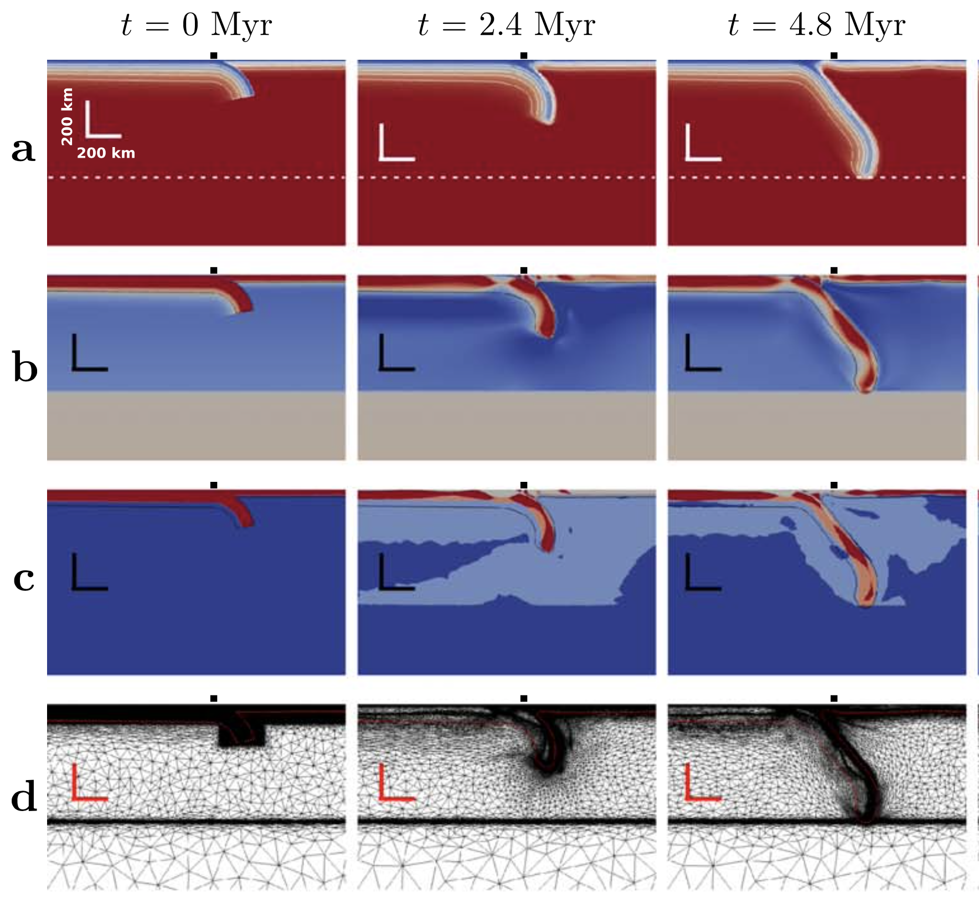
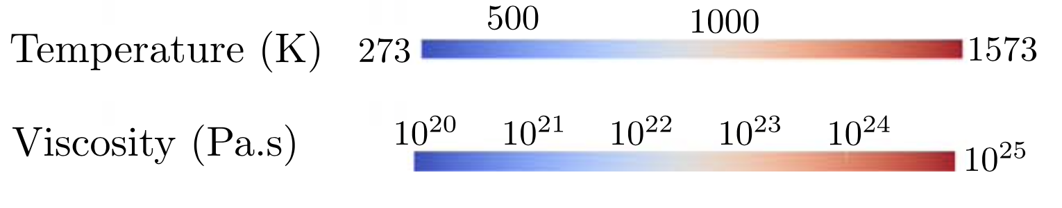
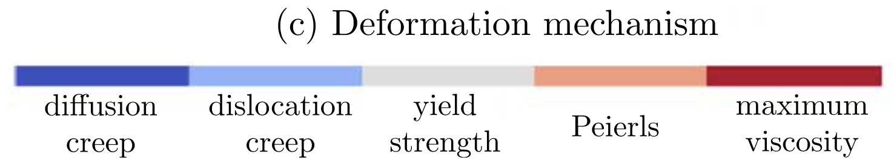
Next class: Viscous flow in the mantle
Garel et al., 2014, G³

Slide 27
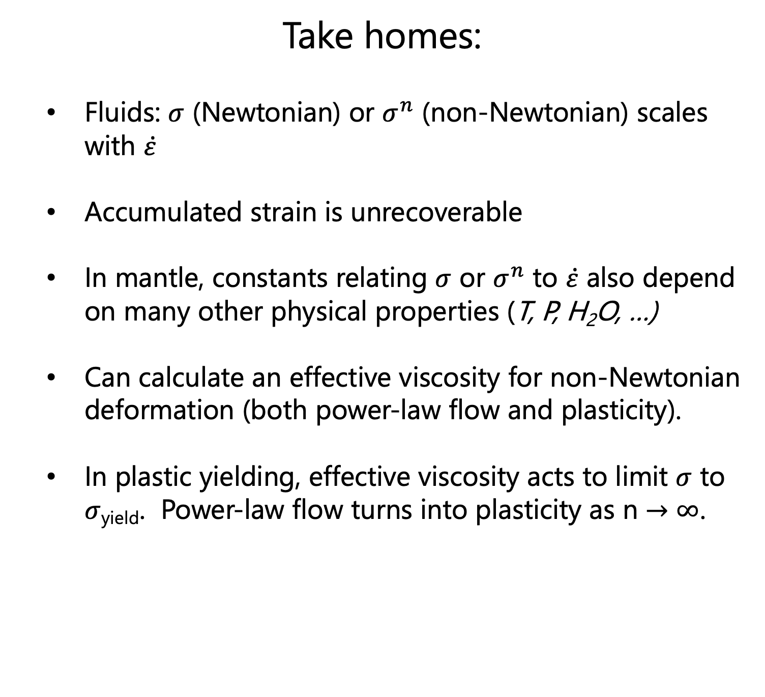
Take homes:
Fluids: $σ$ (Newtonian) or $σ^{n}$ (non-Newtonian) scales with $\dot{ε}$
Accumulated strain is unrecoverable
In mantle, constants relating $σ$ or $σ^{n}$ to $\dot{ε}$ also depend on many other physical properties (T, P, H₂O, …)
Can calculate an effective viscosity for non-Newtonian deformation (both power-law flow and plasticity).
In plastic yielding, effective viscosity acts to limit $σ$ to $σ$_{yield}. Power-law flow turns into plasticity as n $→∞$.

